Slide 1


VISUAL EFFECTS & COMPOSITING

Slide 2
VISUAL EFFECTS

Slide 3
TYPES OF VFX
FLUIDS
PYRO
CLOTH
PARTICLES
DYNAMICS
HAIR & FUR
PROCEDURAL

Slide 4
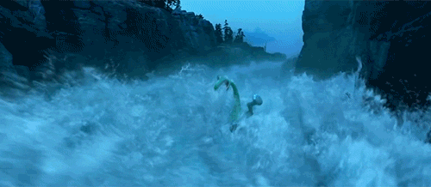
FLUIDS

Slide 5
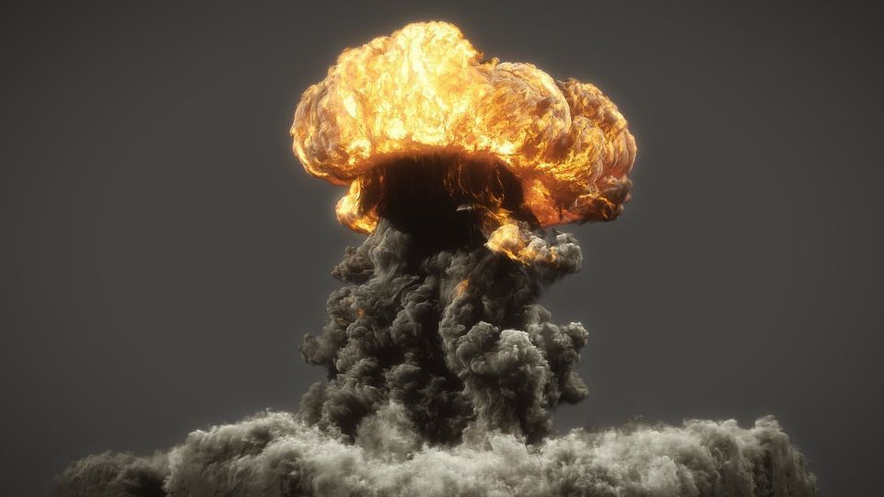
PYRO

Slide 6
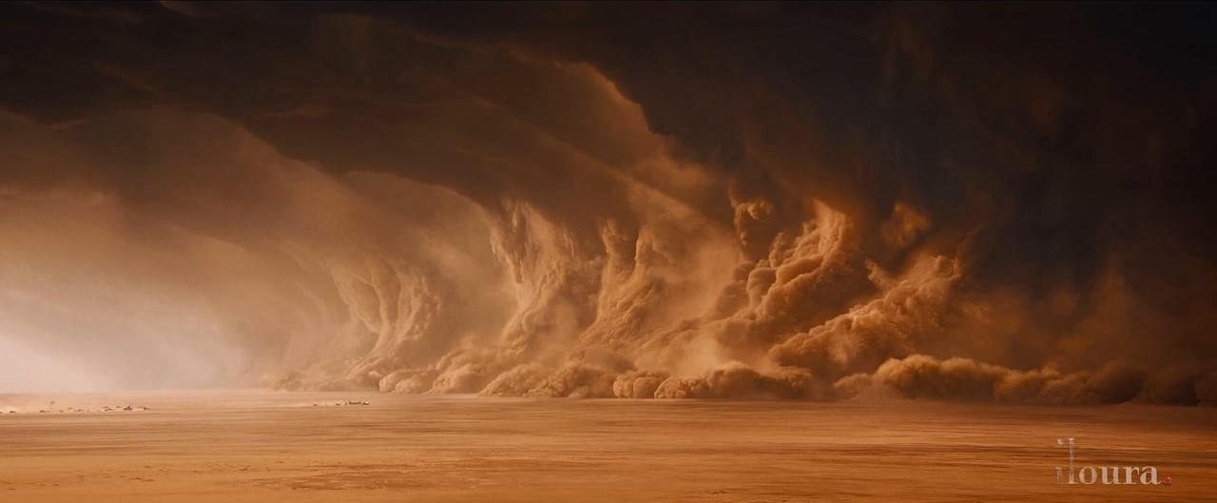
PARTICLES

Slide 7
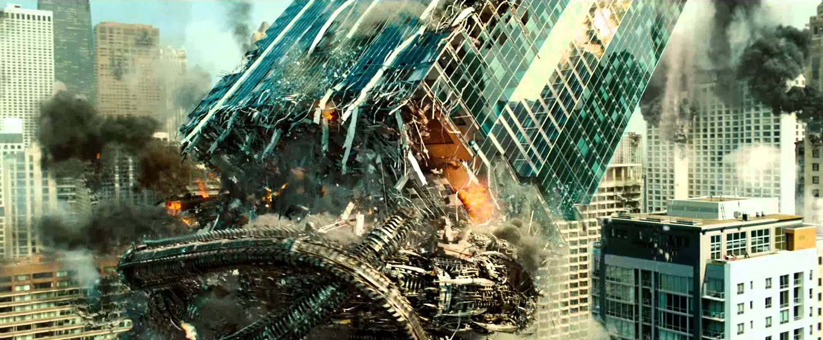
DYNAMICS

Slide 8
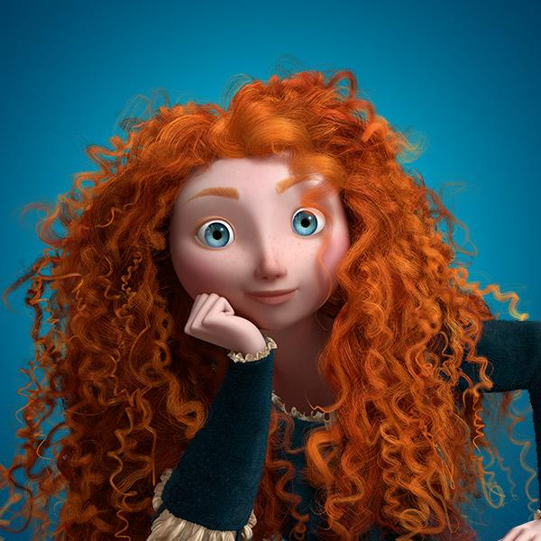
HAIR

Slide 9
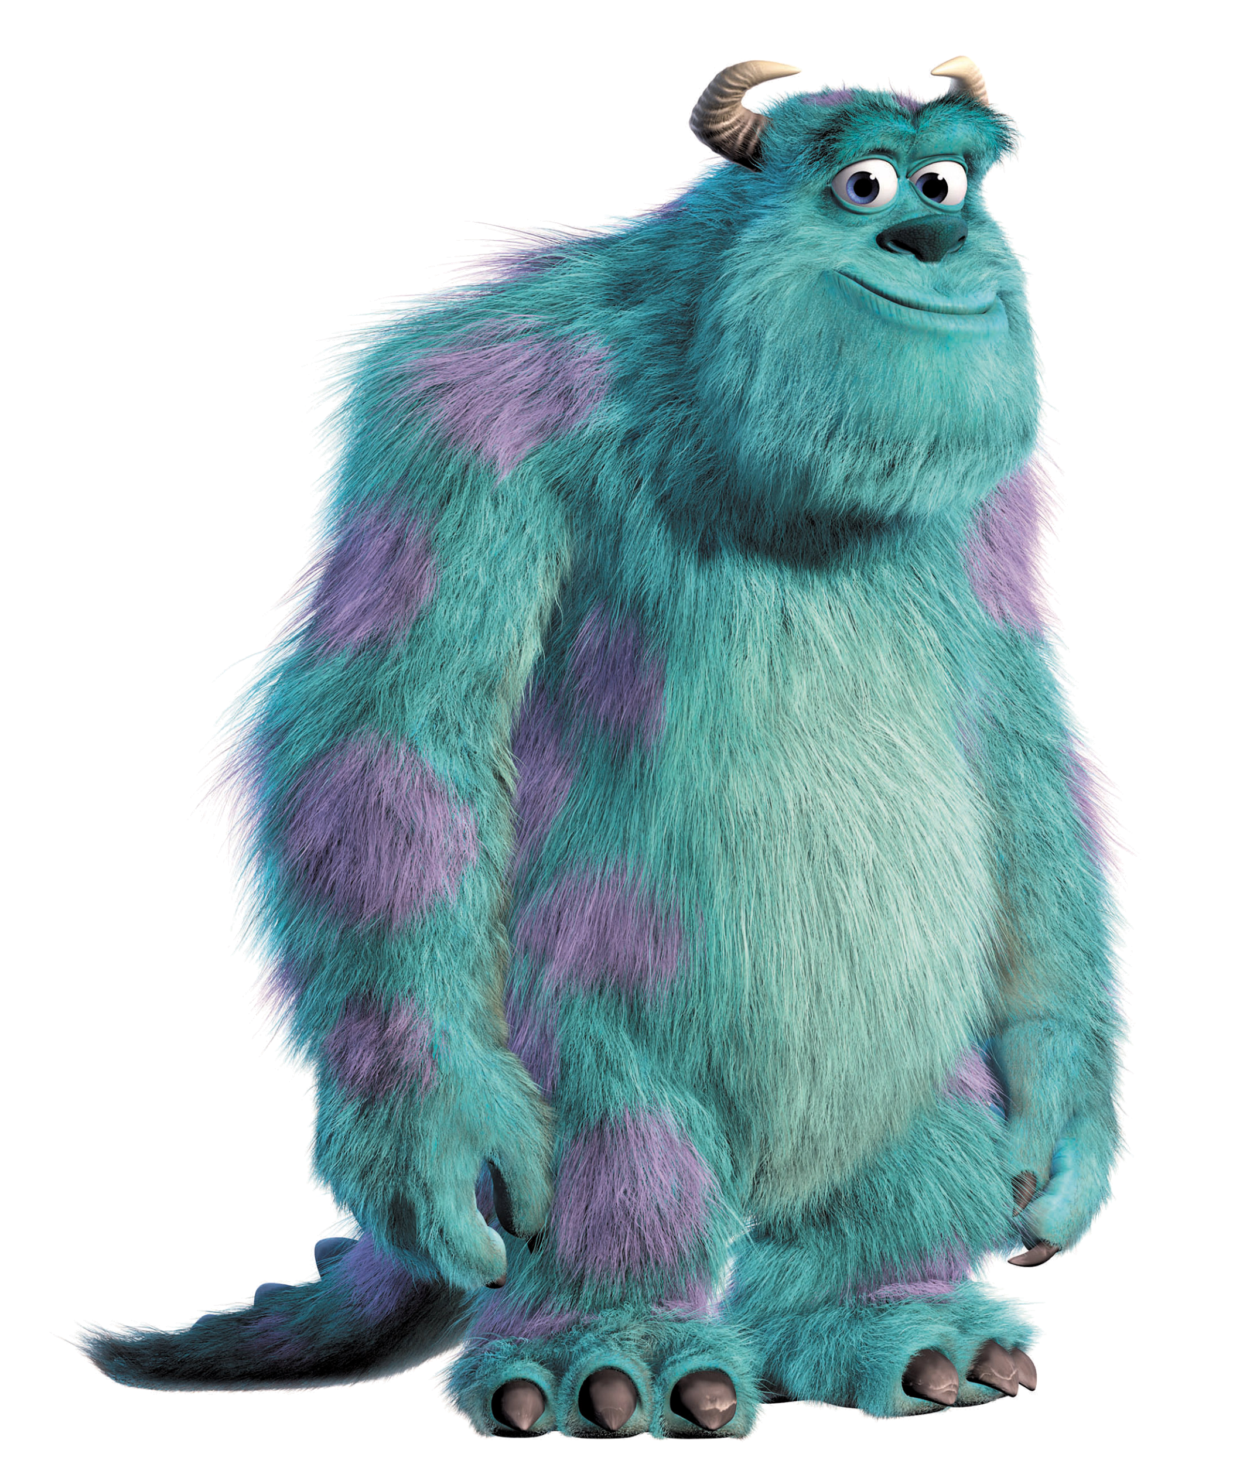
FUR

Slide 10
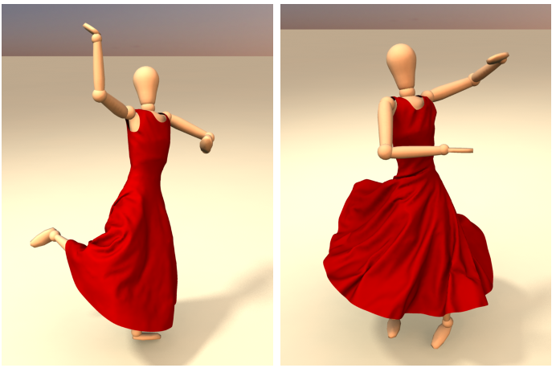
CLOTH

Slide 11
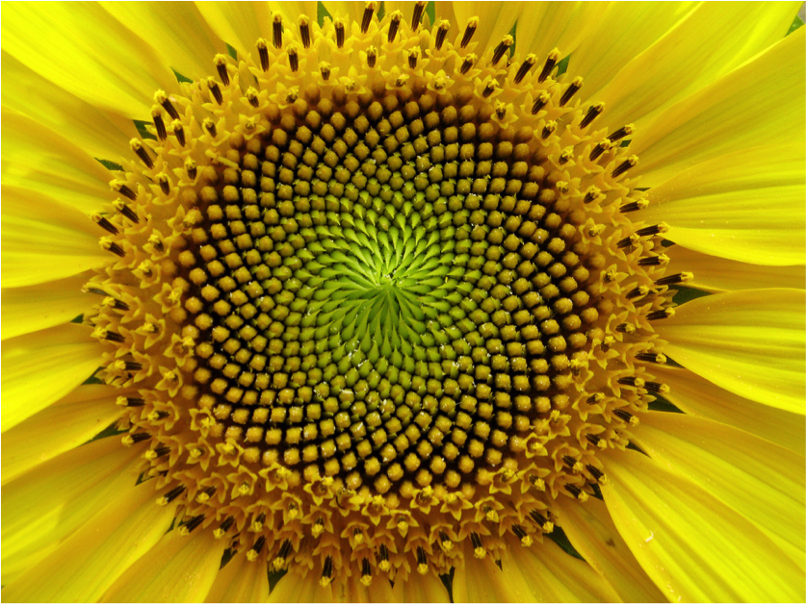
PROCEDURAL GENERATION

Slide 12
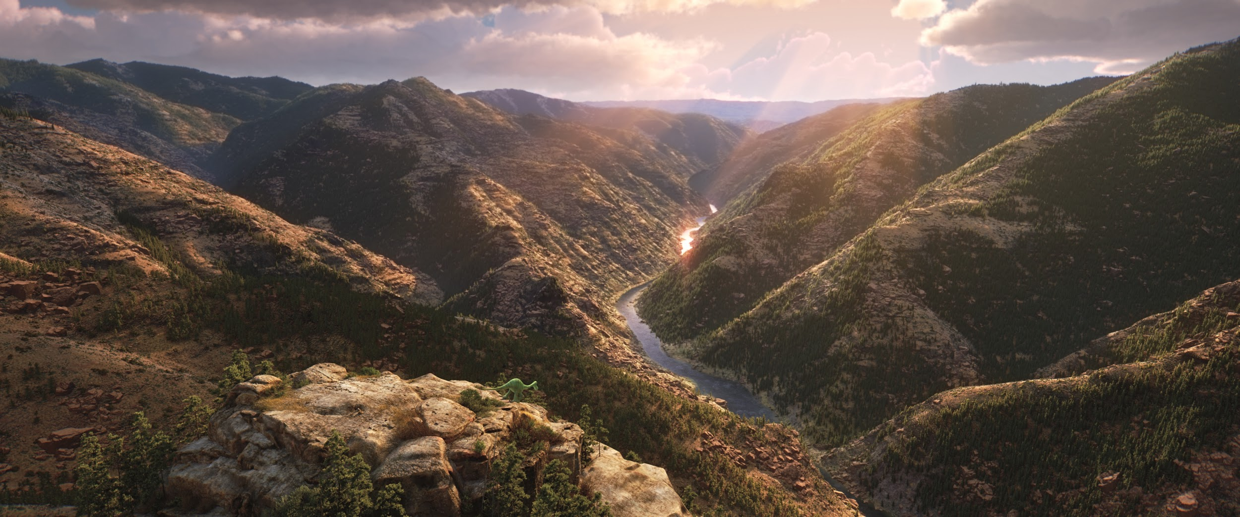
GEOMETRY INSTANCING

Slide 13
CATEGORIES OF VFX
SIMULATED / DIRECTED
STYLIZED / PHOTOREALISTIC
CHARACTER / ENVIRONMENT

Slide 14
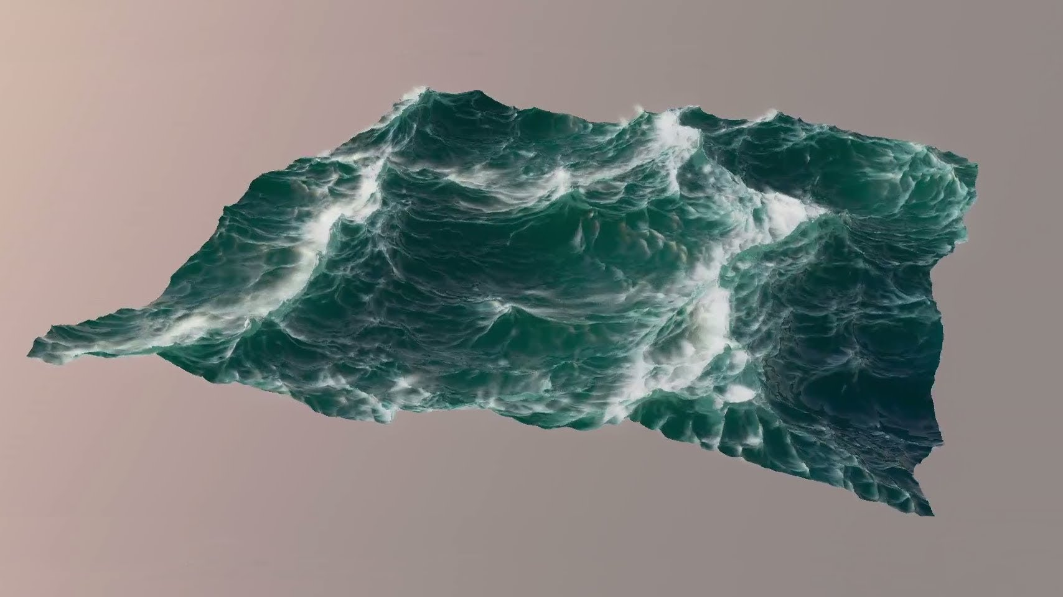
SIMULATED

Slide 15
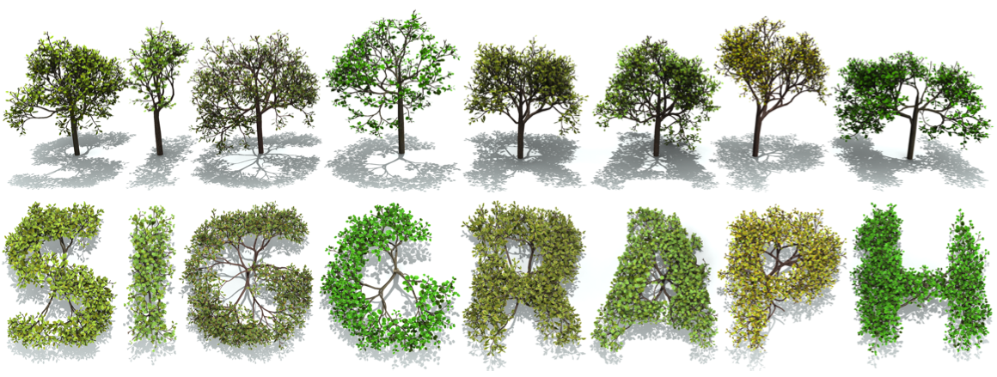
ARTISTICALLY DIRECTED

Slide 16
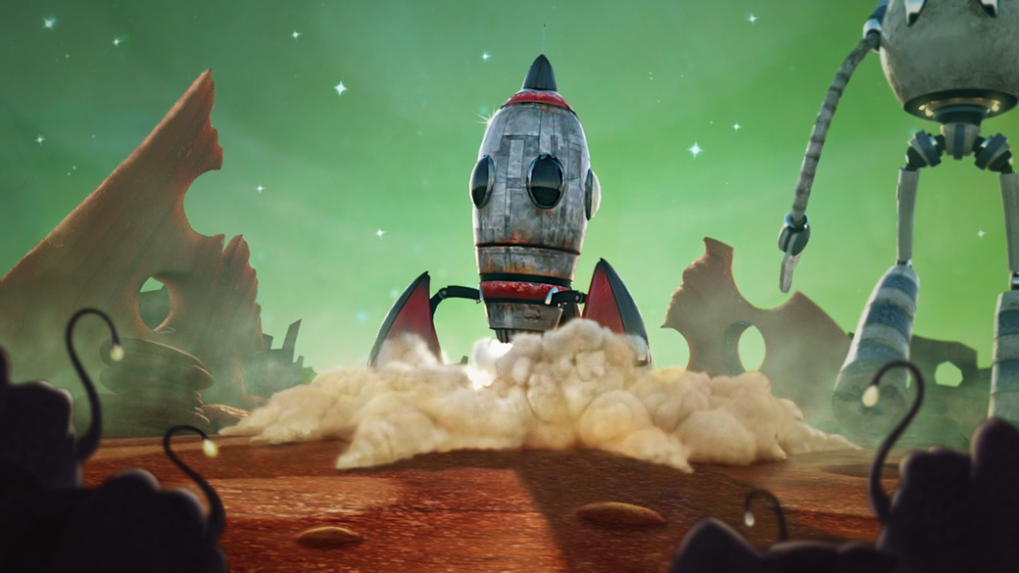
STYLIZED

Slide 17
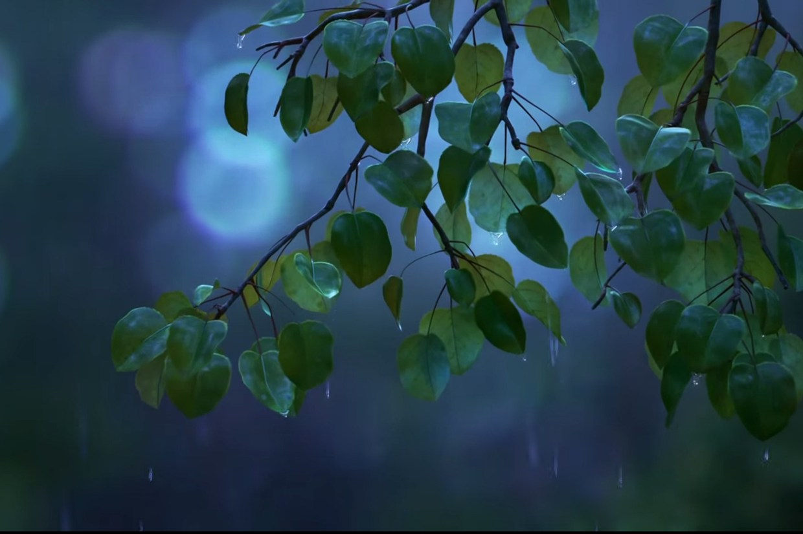
PHOTOREALISTIC

Slide 18
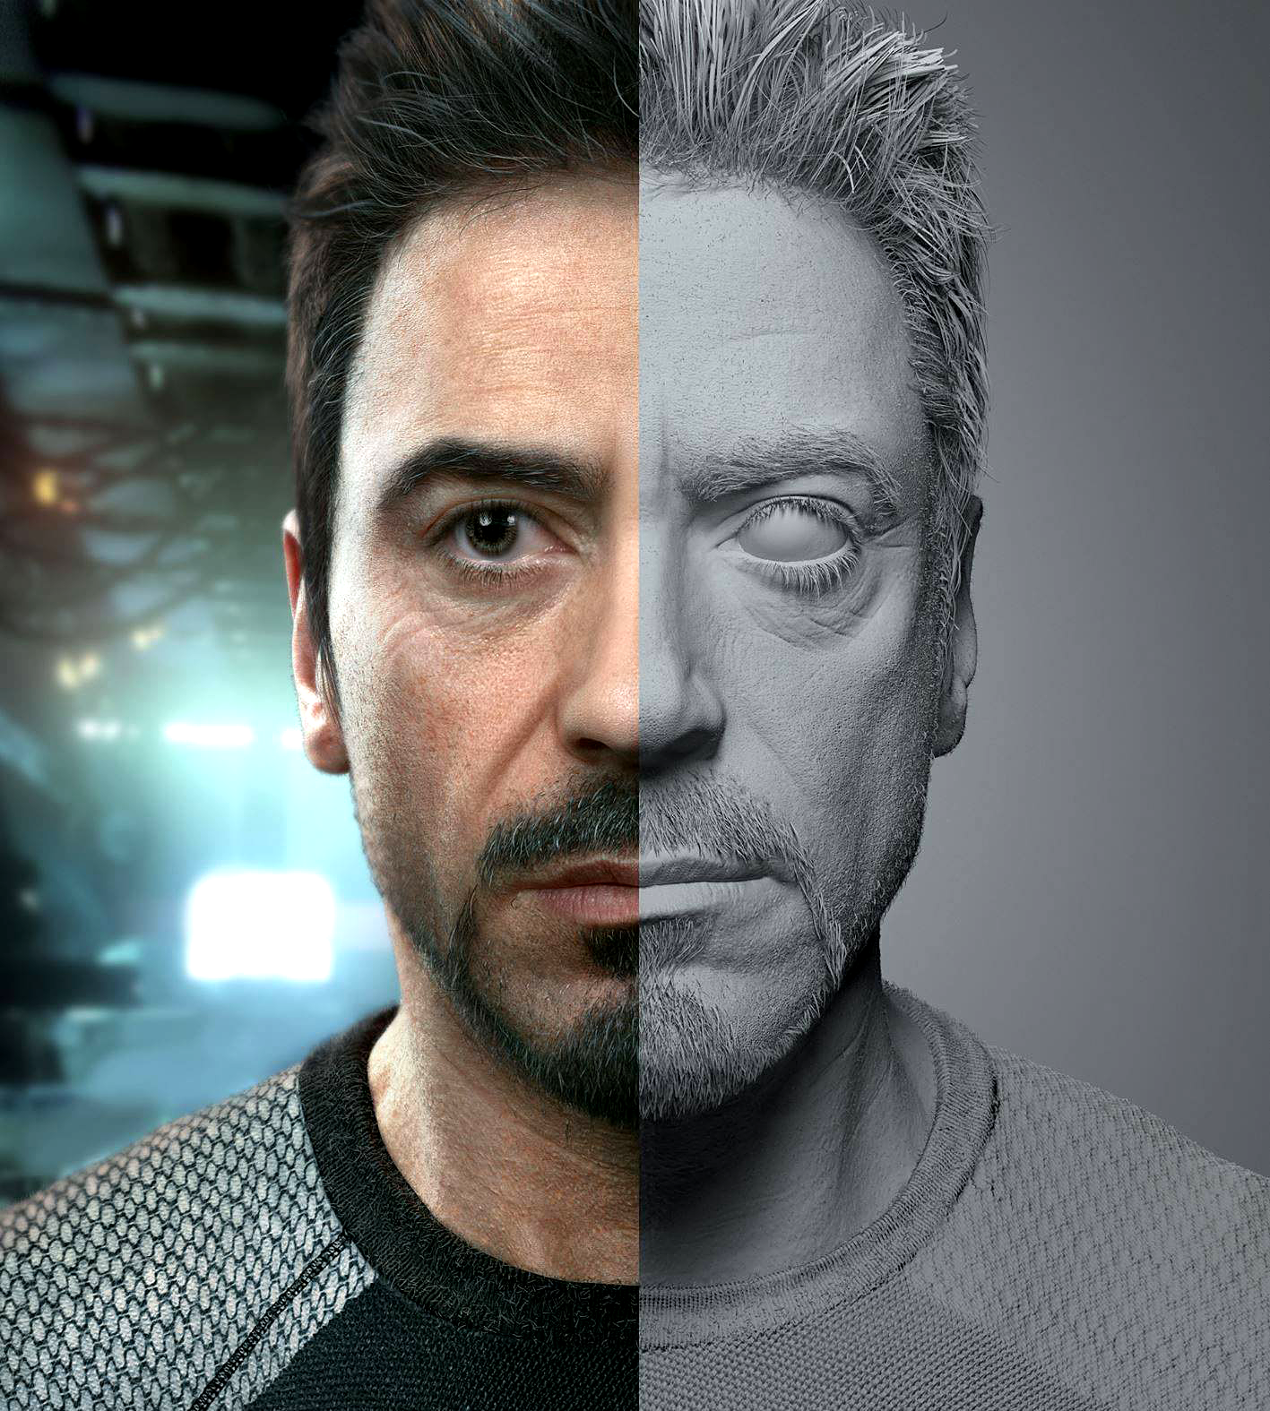
CHARACTER

Slide 19
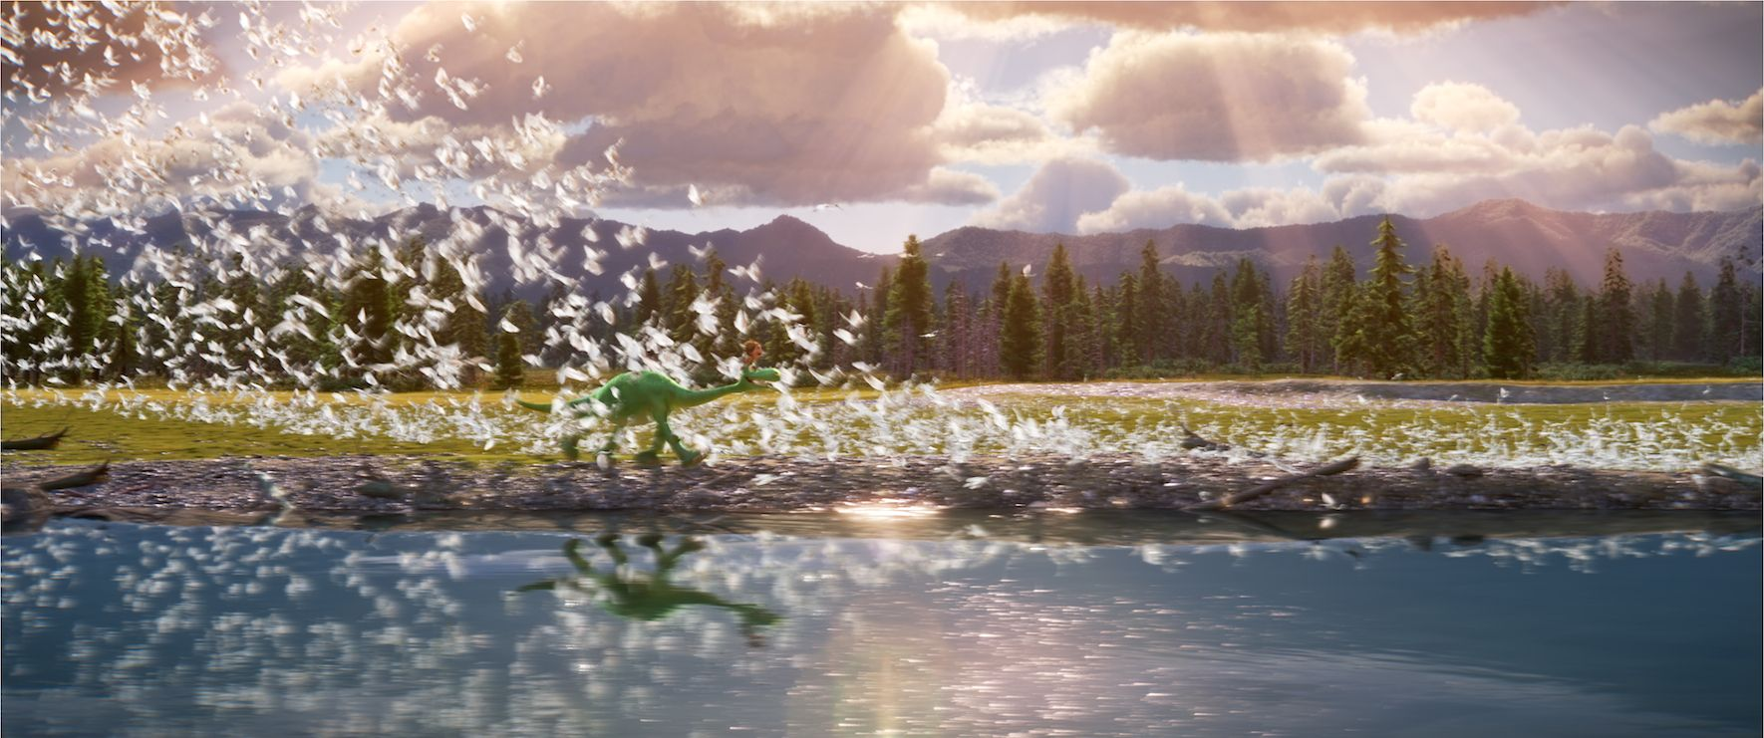
ENVIRONMENT

Slide 20
GENERAL WORKFLOW

Slide 21
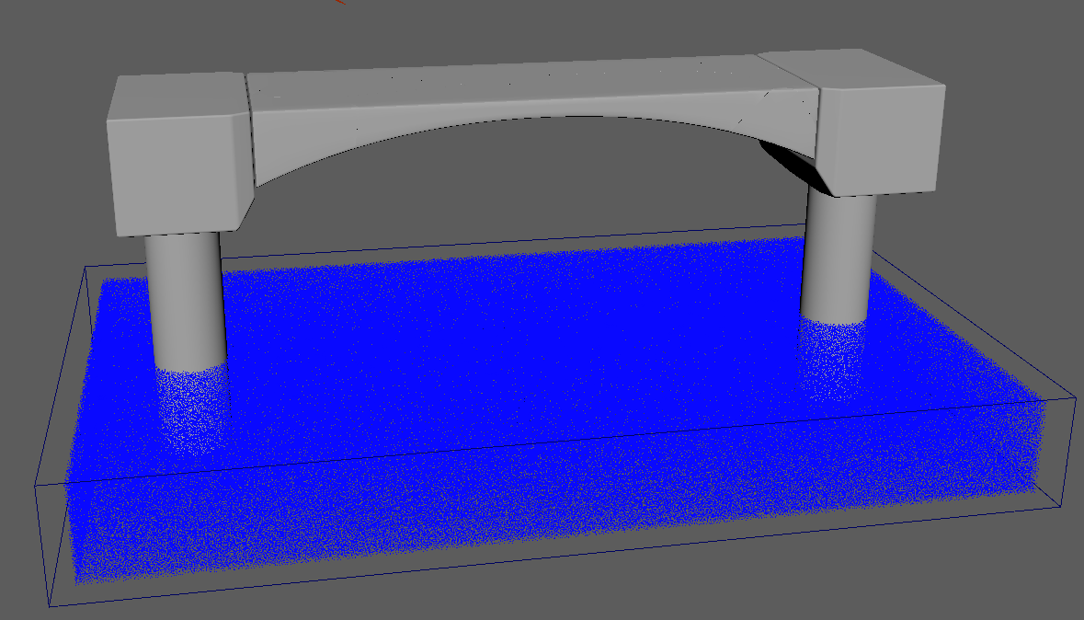
STEP 1 - SET THE SCENE

Slide 22
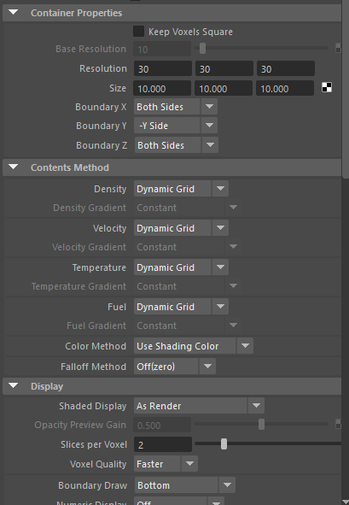
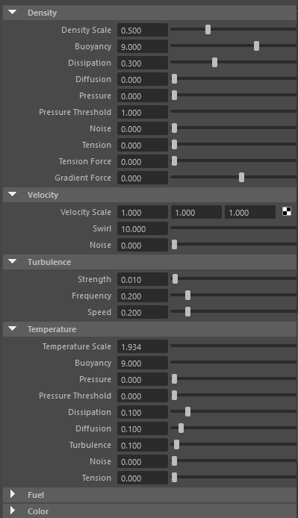
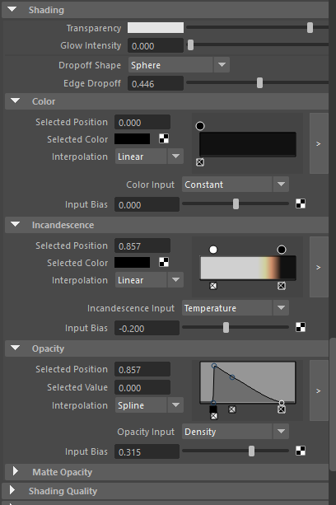
STEP 2 - TWEAK PARAMETERS

Slide 23
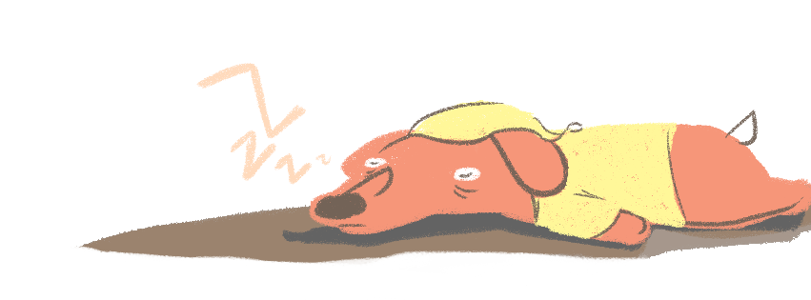
STEP 3 - TAKE A NAP

Slide 24
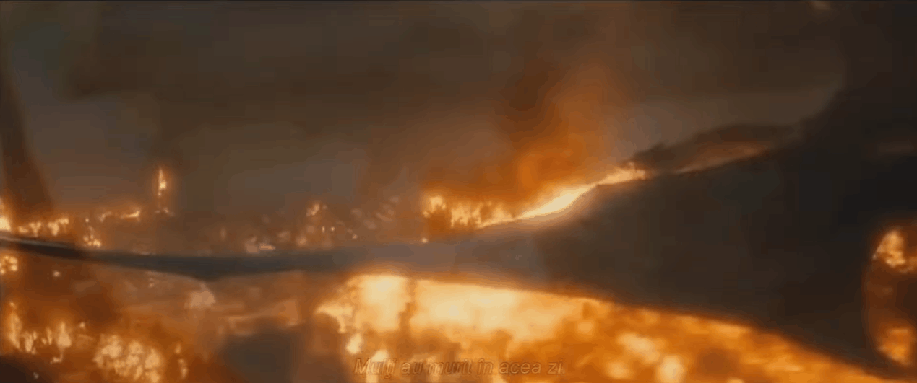
STEP 4 - $$$$$$$$$$$$$$$$$$$$$$$$$$$$$$$$$$

Slide 25
DEMO

Slide 26
TIPS
PLAYBACK SPEED
PERFORMANCE VS. ACCURACY
POLYGON COUNT
VOXEL SIZE
SCALES
EFFECTS INTERACTION

Slide 27
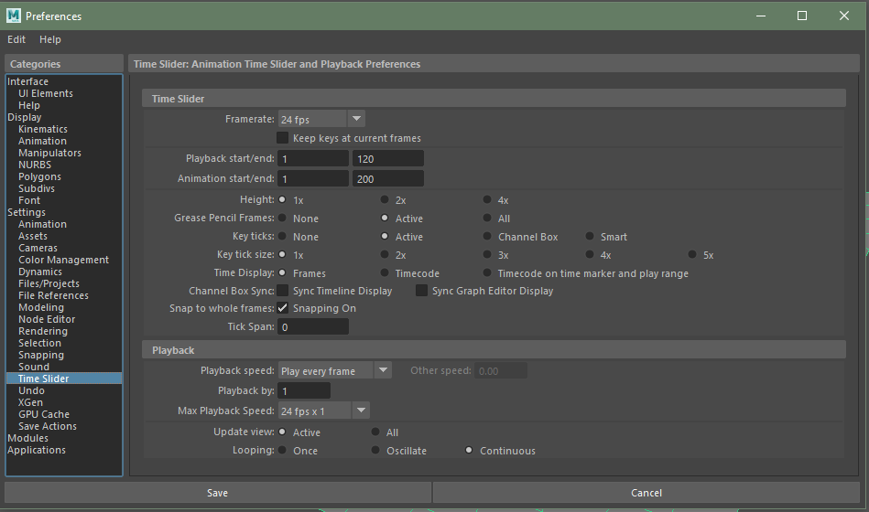
PLAYBACK SPEED
Setting for animation: 24 frames per second
Setting for simulation: Play Every Frame, cap the playback at maximum 24 frames per second.

Slide 28
PERFORMANCE VS. ACCURACY
There is always a trade-off
Low resolution effects generally look similar in shape and behavior to the high resolution ones
Start small, tweak the attributes, and increase the resolution only in the end one you are happy with the general look

Slide 29
POLYGON COUNT AND VOXEL SIZE
Polygons
Patches from which the mesh is constructed. The higher the number of the polygons, the higher the resolution of the mesh is.
Voxels
Three-dimensional set of boxes that forms a grid. Each box in the grid is a voxel which stores the data such as fluid density, direction, temperature, etc. The smaller the voxel size, the higher the resolution of the effect.

Slide 30
SCALES
Scales are very important in simulations
It is best to model to scale, but you can also adjust the scale settings within the simulation engines
Especially important for water: 1 Maya unit = 1 meter, always, whatever your settings are. You need to adjust the gravity and density parameters.

Slide 31
EFFECTS INTERACTION
Effects in Maya may or may not easily interact with each other
Nucleus effects such as nHair, nParticles, nDynamics work well together
Other effects need a lot of tweaking to interact with each other, avoid these

Slide 32
RENDERING
Models
Textures
Lights
Cameras
2D Images and Portions of Images

Slide 33
RenderMan
PROS
Looks fantastic
Fast to tweak
CONS
Slow (3-15 minutes per frame at UCBUGG level)
Incompatible with some built-in effects

Slide 34
Maya Hardware 2.0
PROS
Renders multiple frames per second
Supports Renderman materials AND native Maya materials
CONS
Looks terrible (just slightly better than viewport)
Fancy materials are not supported

Slide 35
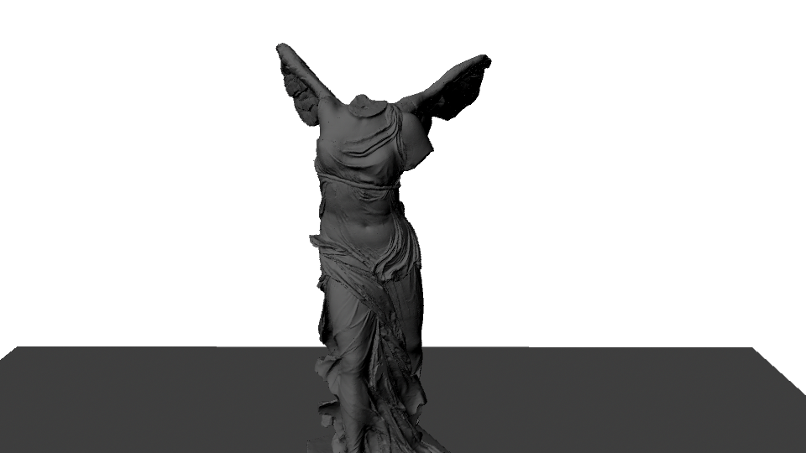
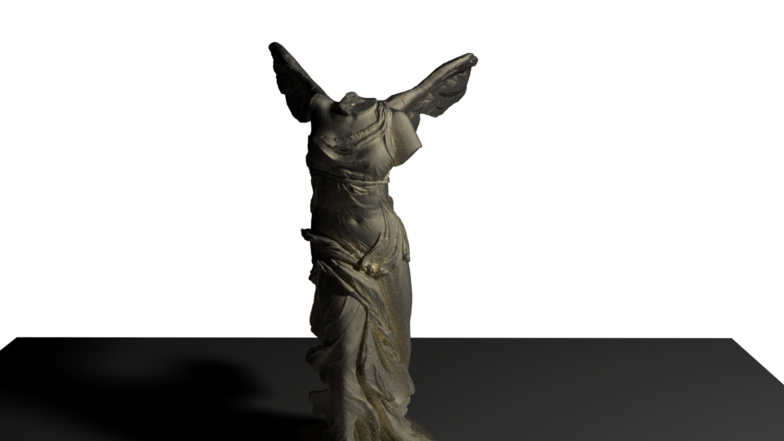
RENDERING SUMMARY
Renderman - Use it for nearly everything
Hardware 2.0 - Last minute desperation

Slide 36
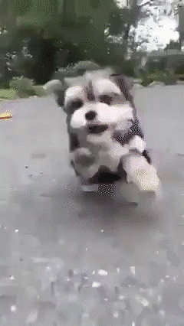
COMPOSITING

Slide 37
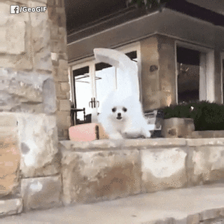
WHAT IS COMPOSITING?
Compiling different images / video clips together
Can be used to save time
Heavily dependent on lighting
Notes:
~Layerz~ as in Photoshop / photo editing

Slide 38
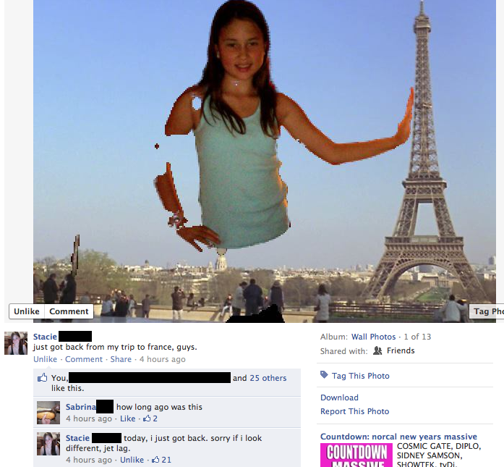

Slide 39

LAYERS
Scene
Layers
Render
Passes
Adjustment Layers

Slide 40
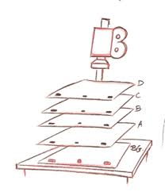
LAYERS
Use multiple layers to correct light and color
Can help render foreground, midground, and background separately
Saves time, especially if foreground and background are static images
Notes:
Different kinds of layers (render passes vs rendering scene separately) - ucbugg usually doesn’t do render passes bc time crunch, but recommended for adv group

Slide 41
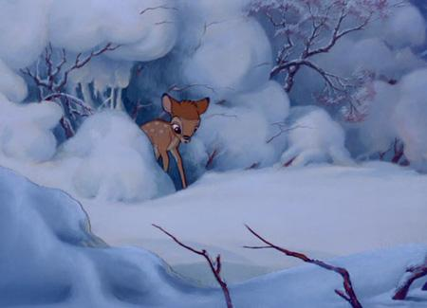

Slide 42
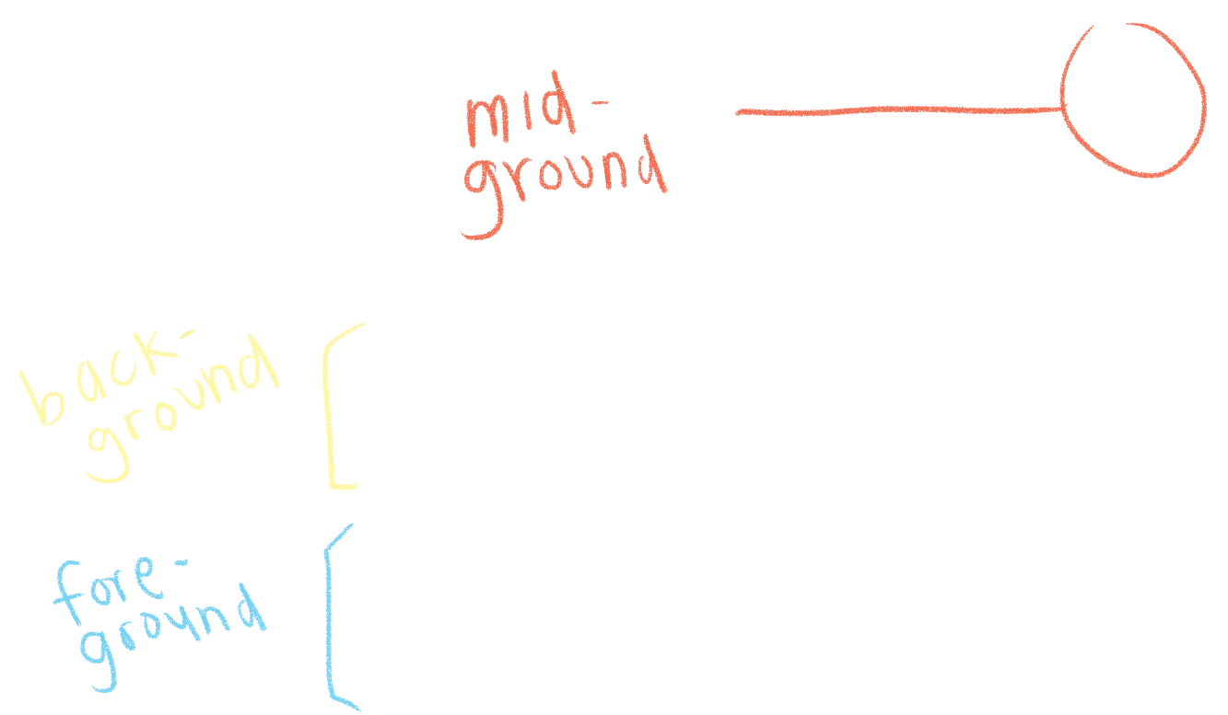
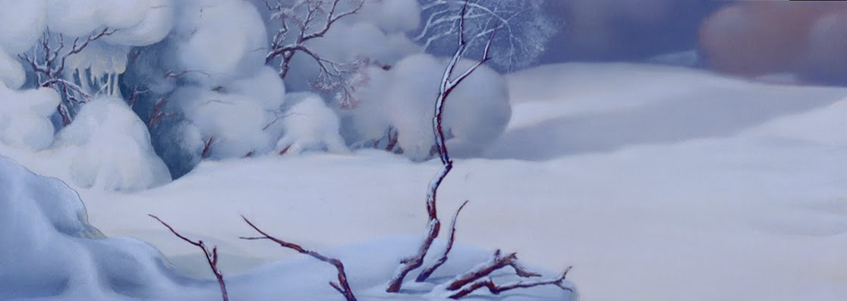
Layers and CEL ANIMATION
Bambi, Walt Disney Animation Studios

Slide 43
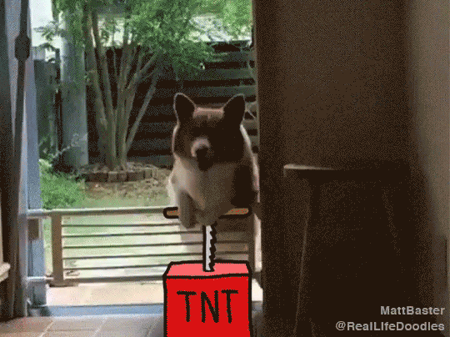

Slide 44
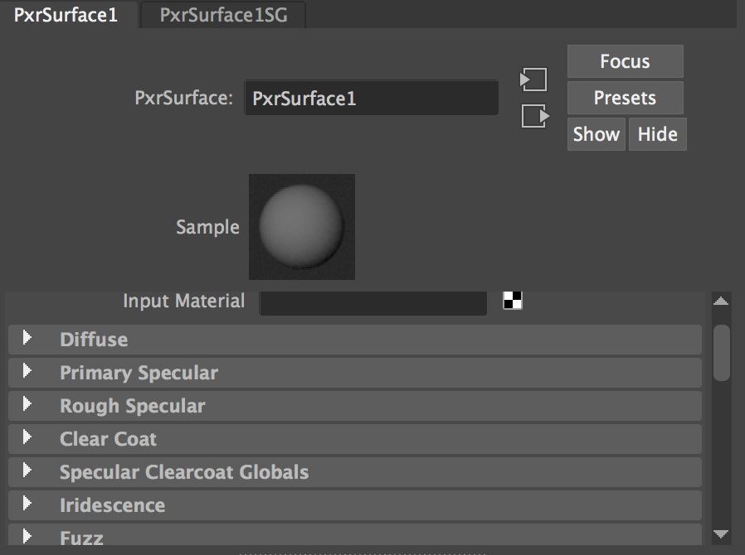
Layers and
RENDER PASSES

Slide 45
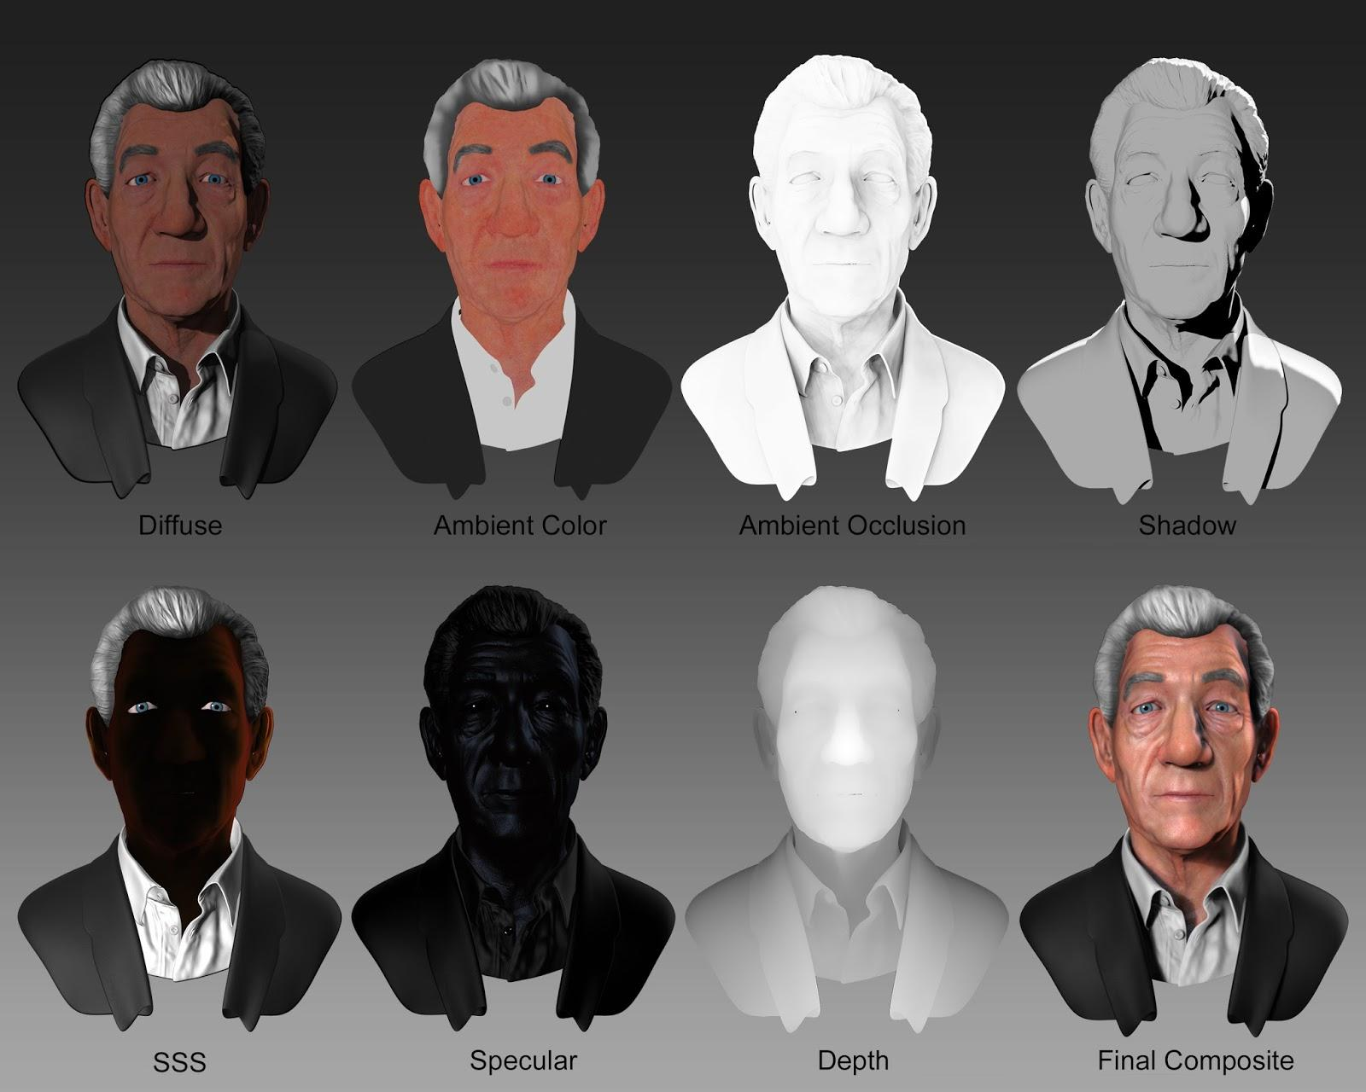

Slide 46
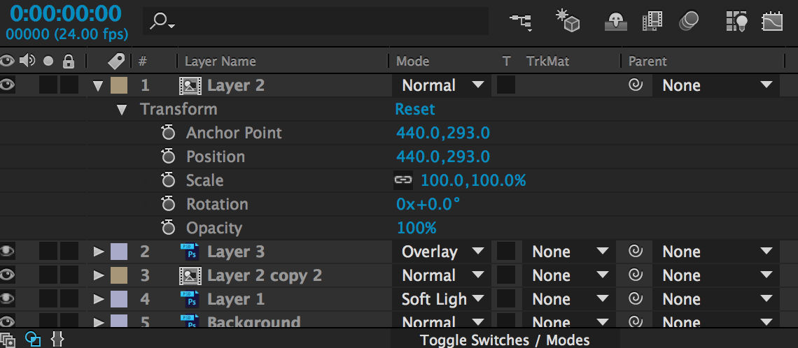
Layers and ADOBE AFTER EFFECTS

Slide 47
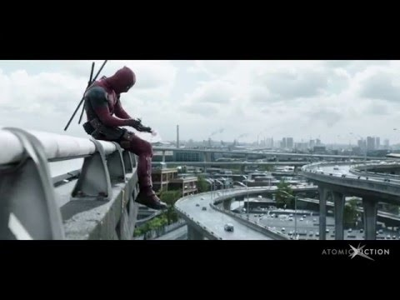
Deadpool, VFX by Atomic Fiction

Slide 48
MATTE PAINTINGS

Slide 49
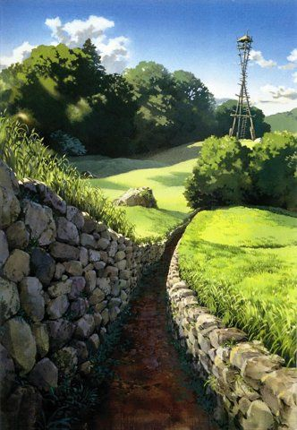
MATTE PAINTINGS
Creates the illusion of depth and distance of a setting
Used to save time (in modeling, rendering, etc.)
Remember to stay consistent with color and lighting!
Princess Mononoke, Studio Ghibli, Kazuo Oga
Notes:
Relate back to the idea of ~compositing~ bc ~layerz~
Also style lmao

Slide 50
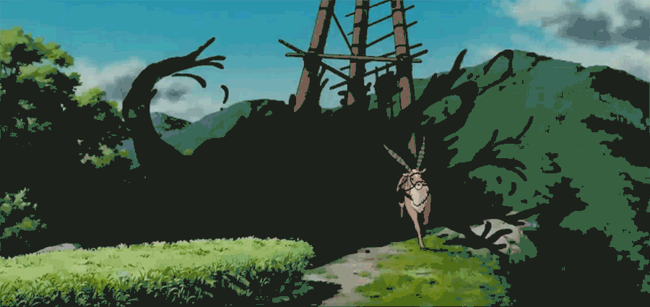
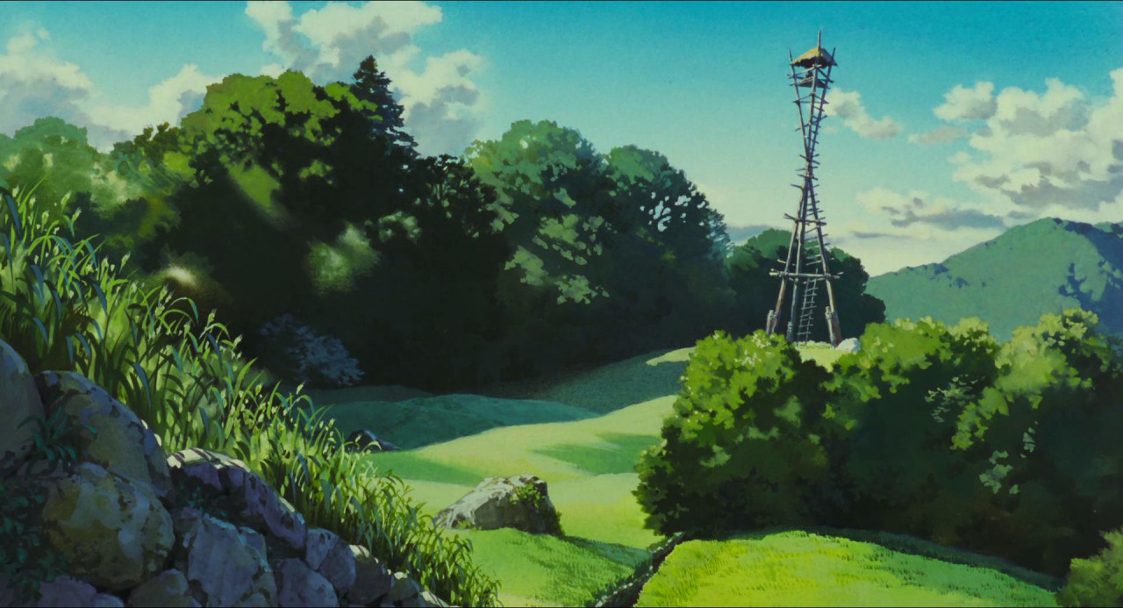
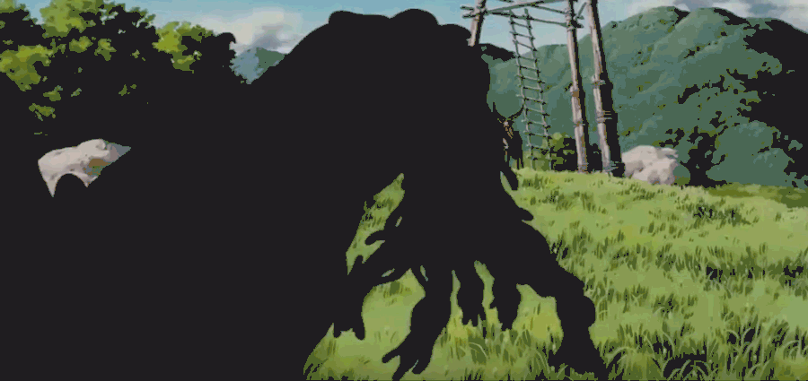

Slide 51
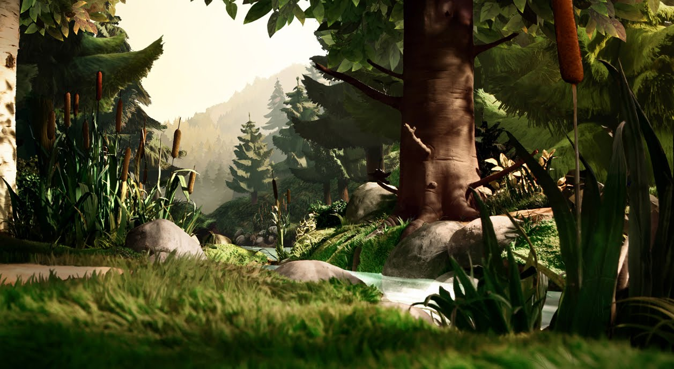
The Gruffalo, Alexander Lindner

Slide 52
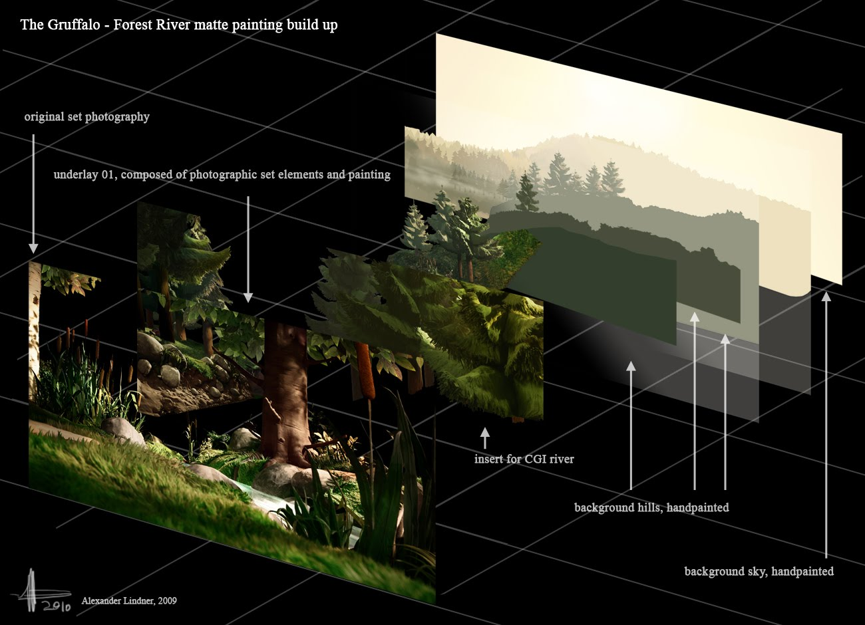

Slide 53
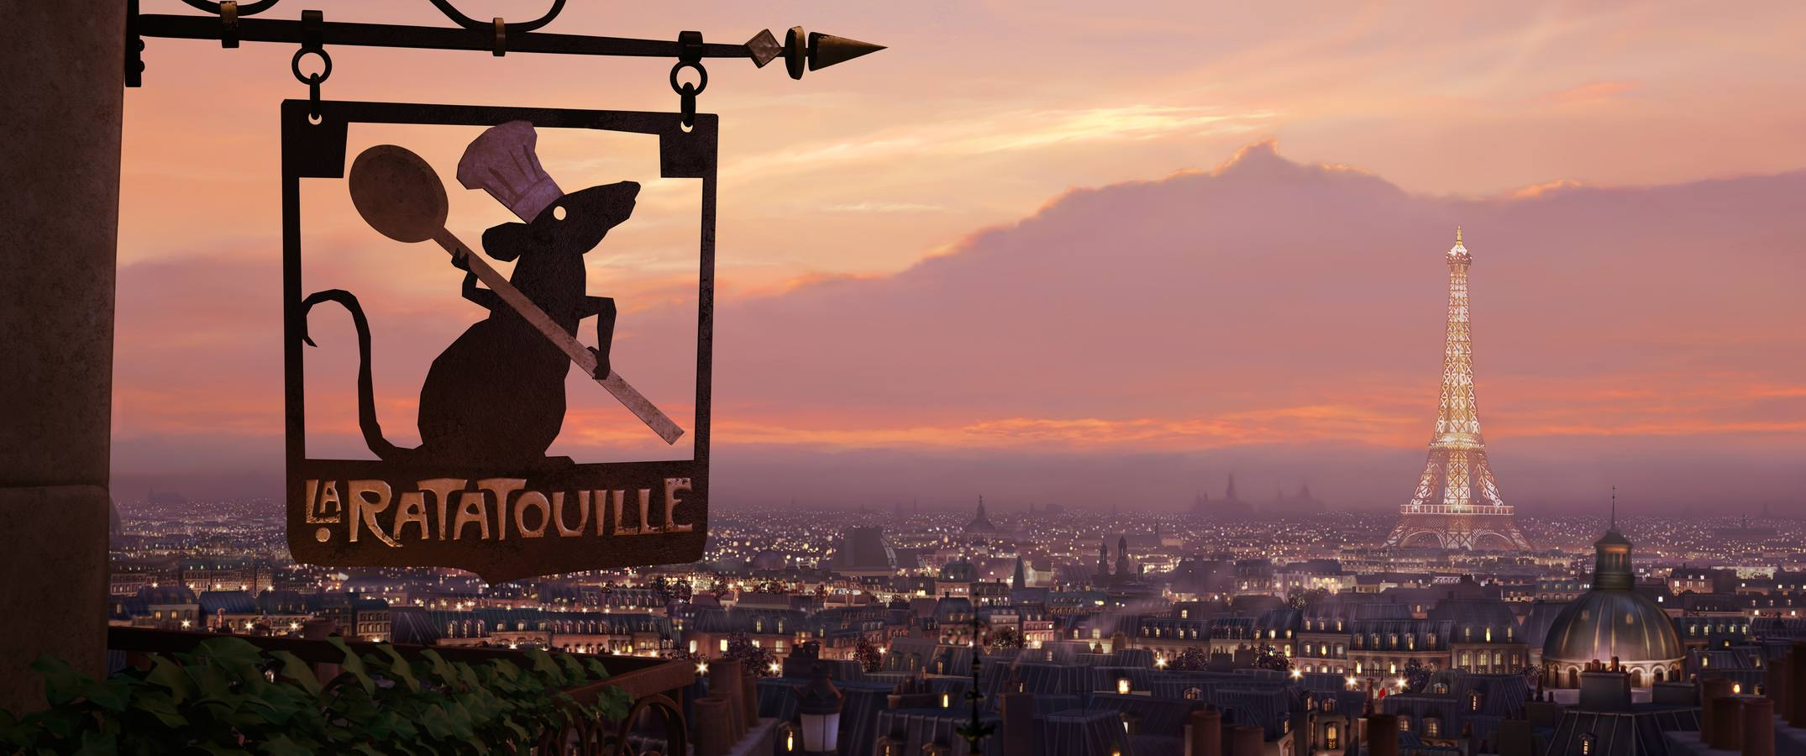
Ratatouille, Pixar Animation Studios, Paul Topolos

Slide 54
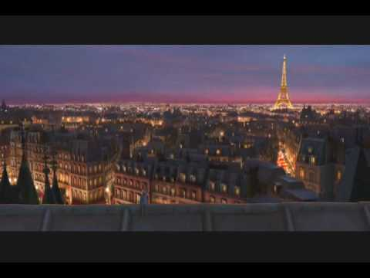
Ratatouille, Pixar Animation Studios

Slide 55
PUTTING IT ALL TOGETHER
(Literally)

Slide 56
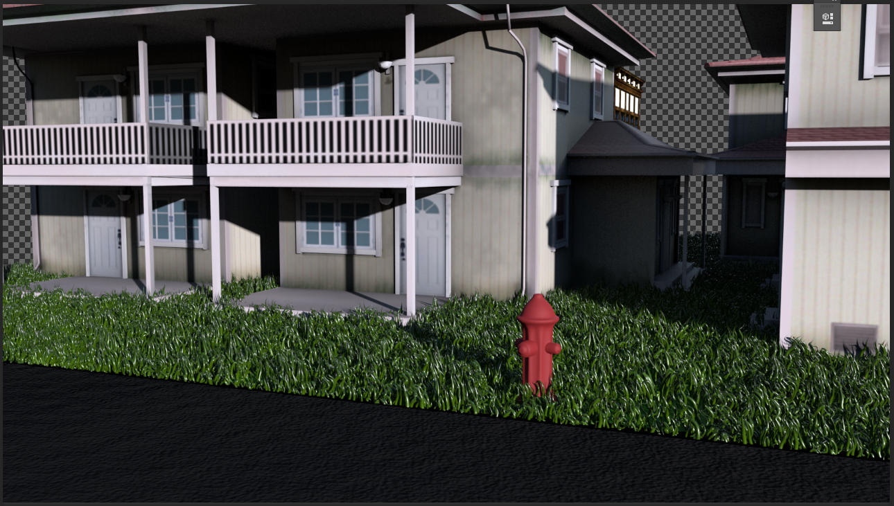

Slide 57
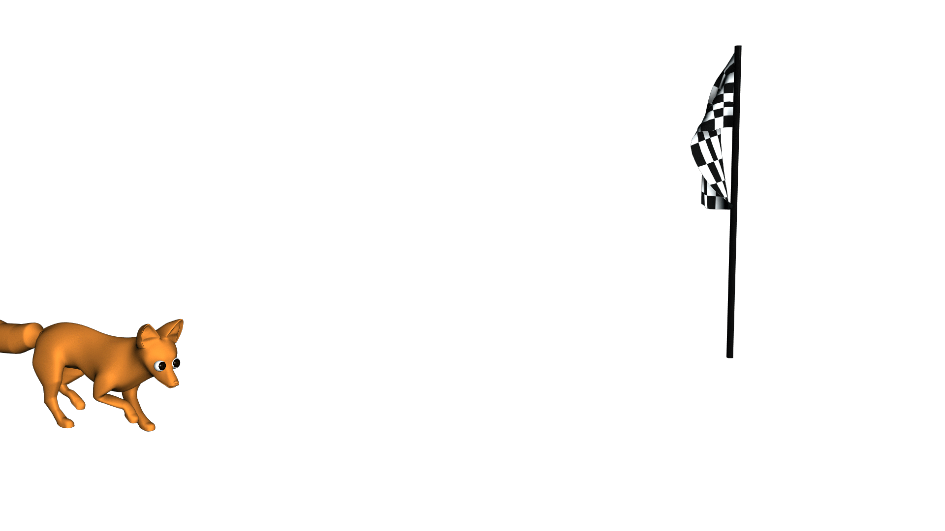
This background is transparent

Slide 58


Slide 59
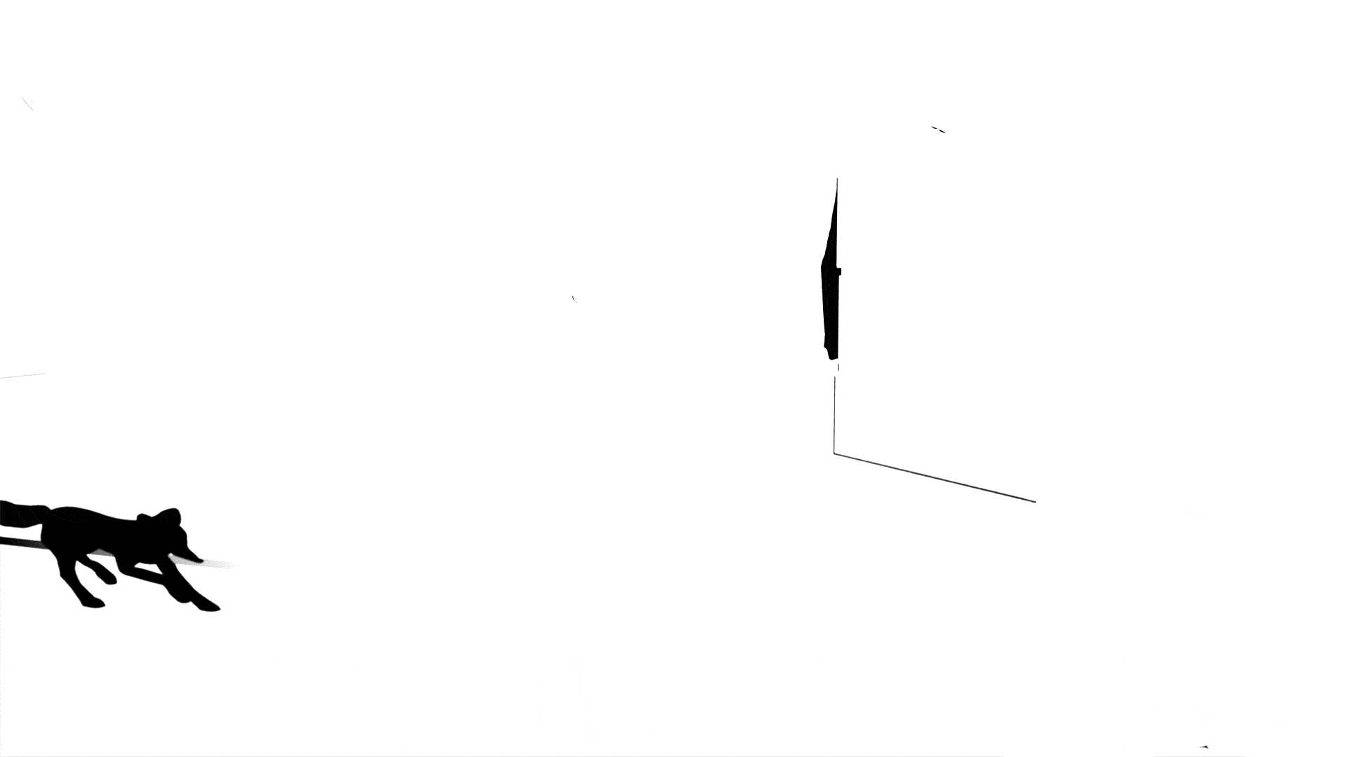

Slide 60
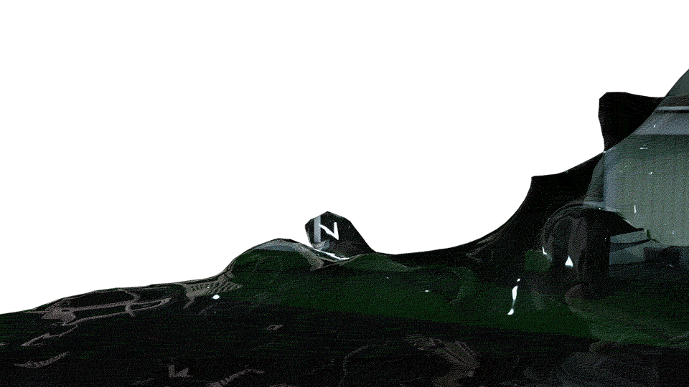

Slide 61


Slide 62
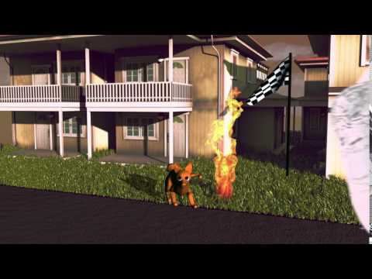

Slide 63
HOMEWORK
ONE VFX LAB PER PERSON
(Water/Fire/Cloth, not PaintFX)
ONE COMPOSITING LAB PER GROUP
.MP4 FILE FORMAT

